Slide 1



Deep LEARNING
How to talk to your cat about
Gaurav Manek LKC Lab, IMCB
Notes:
Almost titled this talk.
In this talk, I will be using one and exactly one equation: y = mx + c

Slide 2
Is a Deep Neural Network?
What
How
When
When
should I use them?
Should I use them?
Should I not use them?

Slide 3

What is a neural network?
How do they work?
When should I use them?
When should I not use them?
How can I use them to make my work better or easier?

Slide 4
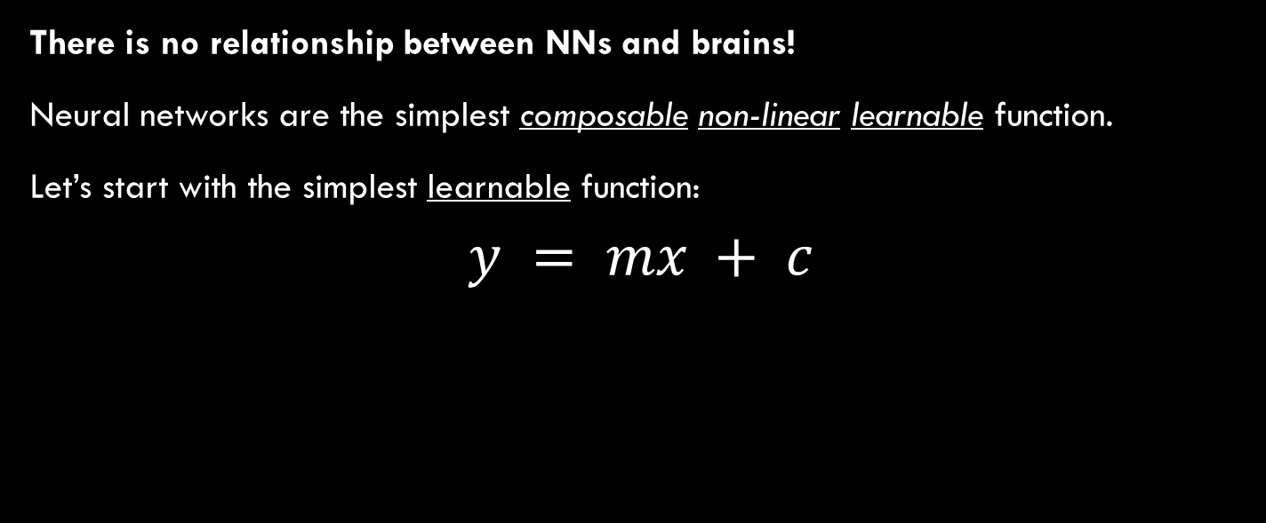
neural networks and the Brain
Marketing!
There is no relationship between NNs and brains!
Neural networks are the simplest composable non-linear learnable function.
Let’s start with the simplest learnable function:
$$y = mx + c$$

Slide 5



Neural networks are the simplest composable non-linear learnable function.
Let’s start with the simplest learnable function:
$$y = mx + c$$
One Output
One Input
$$y$$
$$x$$

Slide 6

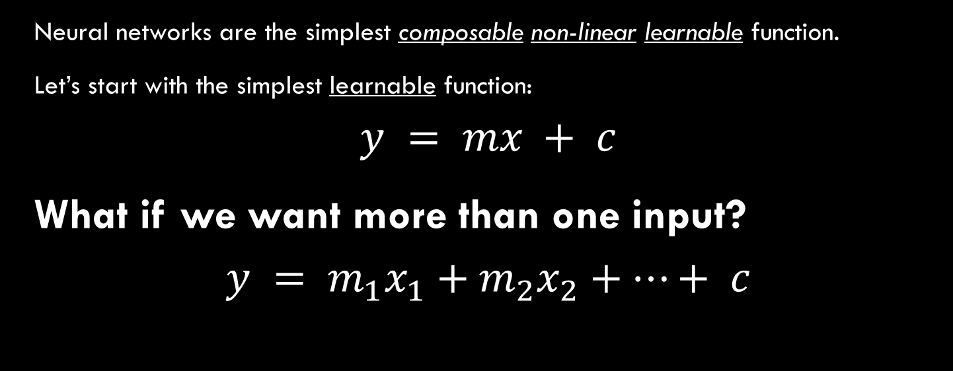


Neural networks are the simplest composable non-linear learnable function.
Let’s start with the simplest learnable function:
$$y = mx + c$$
What if we want more than one input?
$$y = m_{1}x_{1}+m_{2}x_{2}+…+ c$$
$$y$$
$$x_{2}$$
$$x_{1}$$

Slide 7
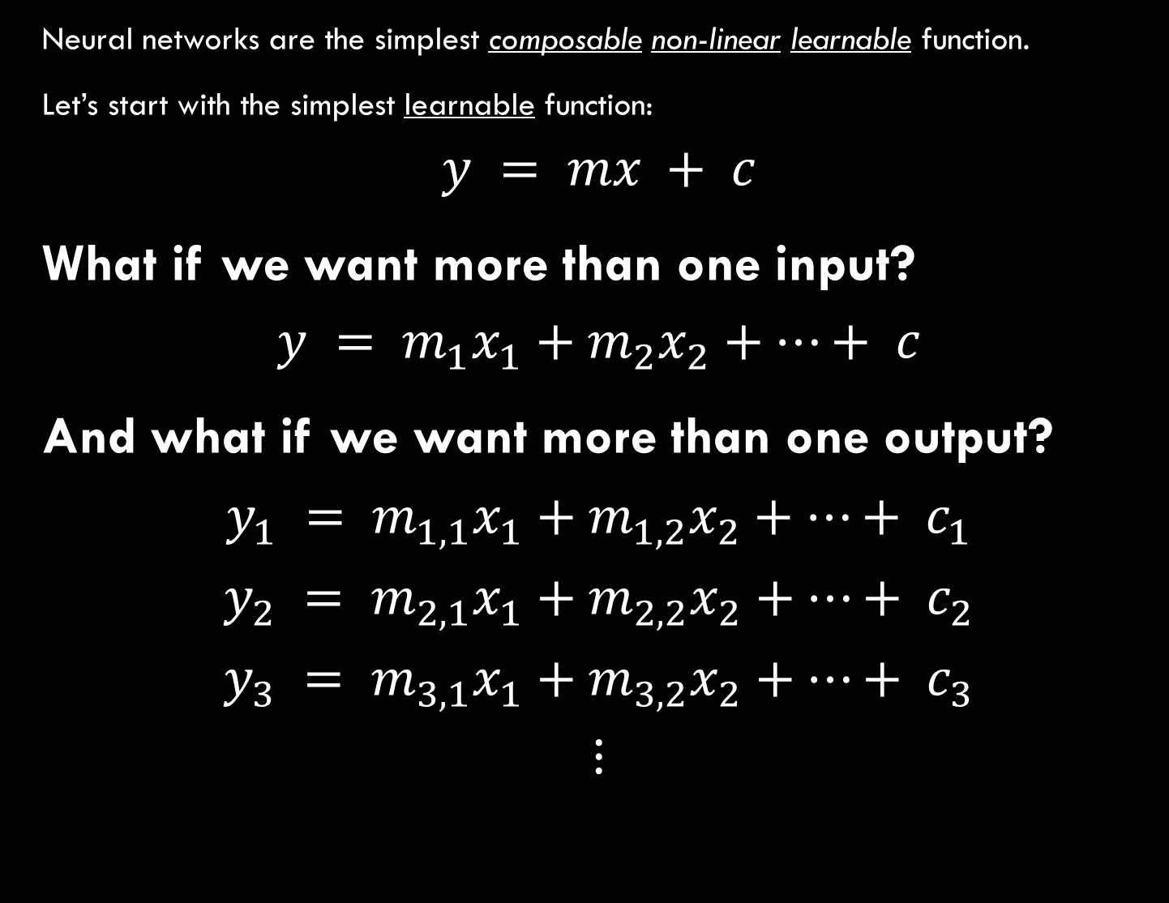
Neural networks are the simplest composable non-linear learnable function.
Let’s start with the simplest learnable function:
$$y = mx + c$$
What if we want more than one input?
$$y = m_{1}x_{1}+m_{2}x_{2}+…+ c$$
And what if we want more than one output?
$$y_{1} = m_{1,1}x_{1}+m_{1,2}x_{2}+…+ c_{1}$$
$$y_{2} = m_{2,1}x_{1}+m_{2,2}x_{2}+…+ c_{2}$$
$$y_{3} = m_{3,1}x_{1}+m_{3,2}x_{2}+…+ c_{3}$$
$$⋮$$
Image from https://rpubs.com/pjozefek/576206

Slide 8
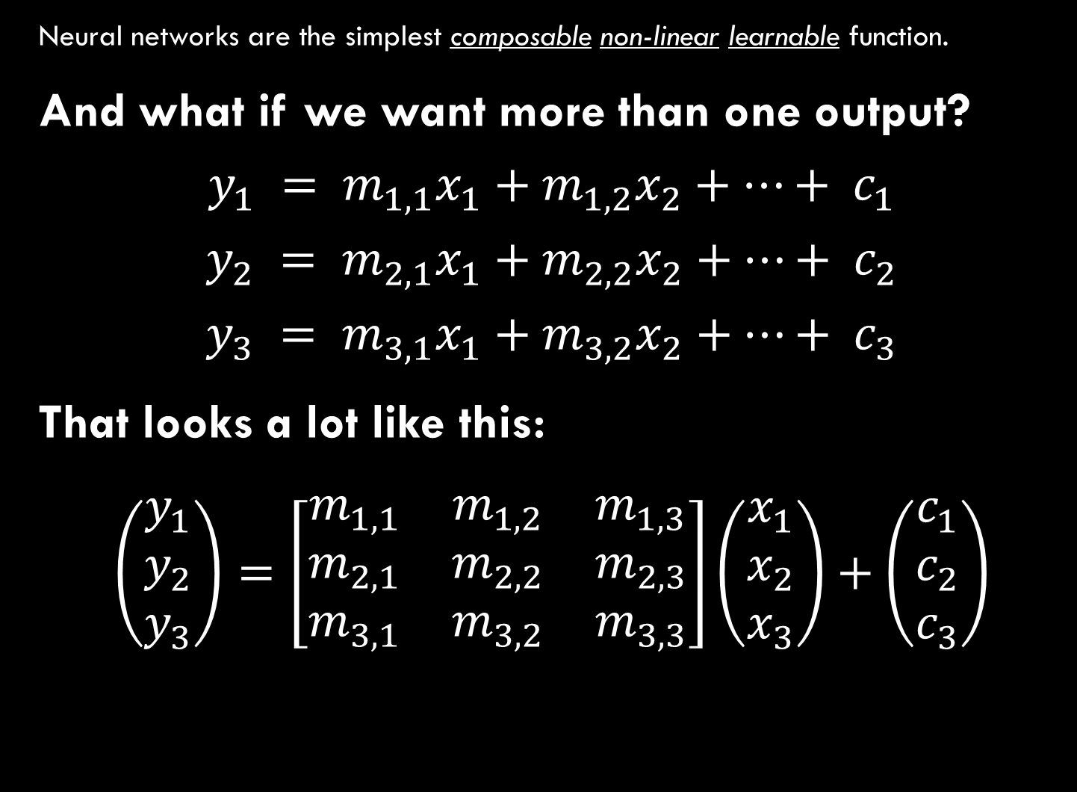
Neural networks are the simplest composable non-linear learnable function.
And what if we want more than one output?
$$y_{1} = m_{1,1}x_{1}+m_{1,2}x_{2}+…+ c_{1}$$
$$y_{2} = m_{2,1}x_{1}+m_{2,2}x_{2}+…+ c_{2}$$
$$y_{3} = m_{3,1}x_{1}+m_{3,2}x_{2}+…+ c_{3}$$
That looks a lot like this:
$$\left(\begin{matrix}y_{1} \\ y_{2} \\ y_{3}\end{matrix}\right)=\left[\begin{matrix}m_{1,1} & m_{1,2} & m_{1,3} \\ m_{2,1} & m_{2,2} & m_{2,3} \\ m_{3,1} & m_{3,2} & m_{3,3}\end{matrix}\right]\left(\begin{matrix}x_{1} \\ x_{2} \\ x_{3}\end{matrix}\right)+\left(\begin{matrix}c_{1} \\ c_{2} \\ c_{3}\end{matrix}\right)$$

Slide 9

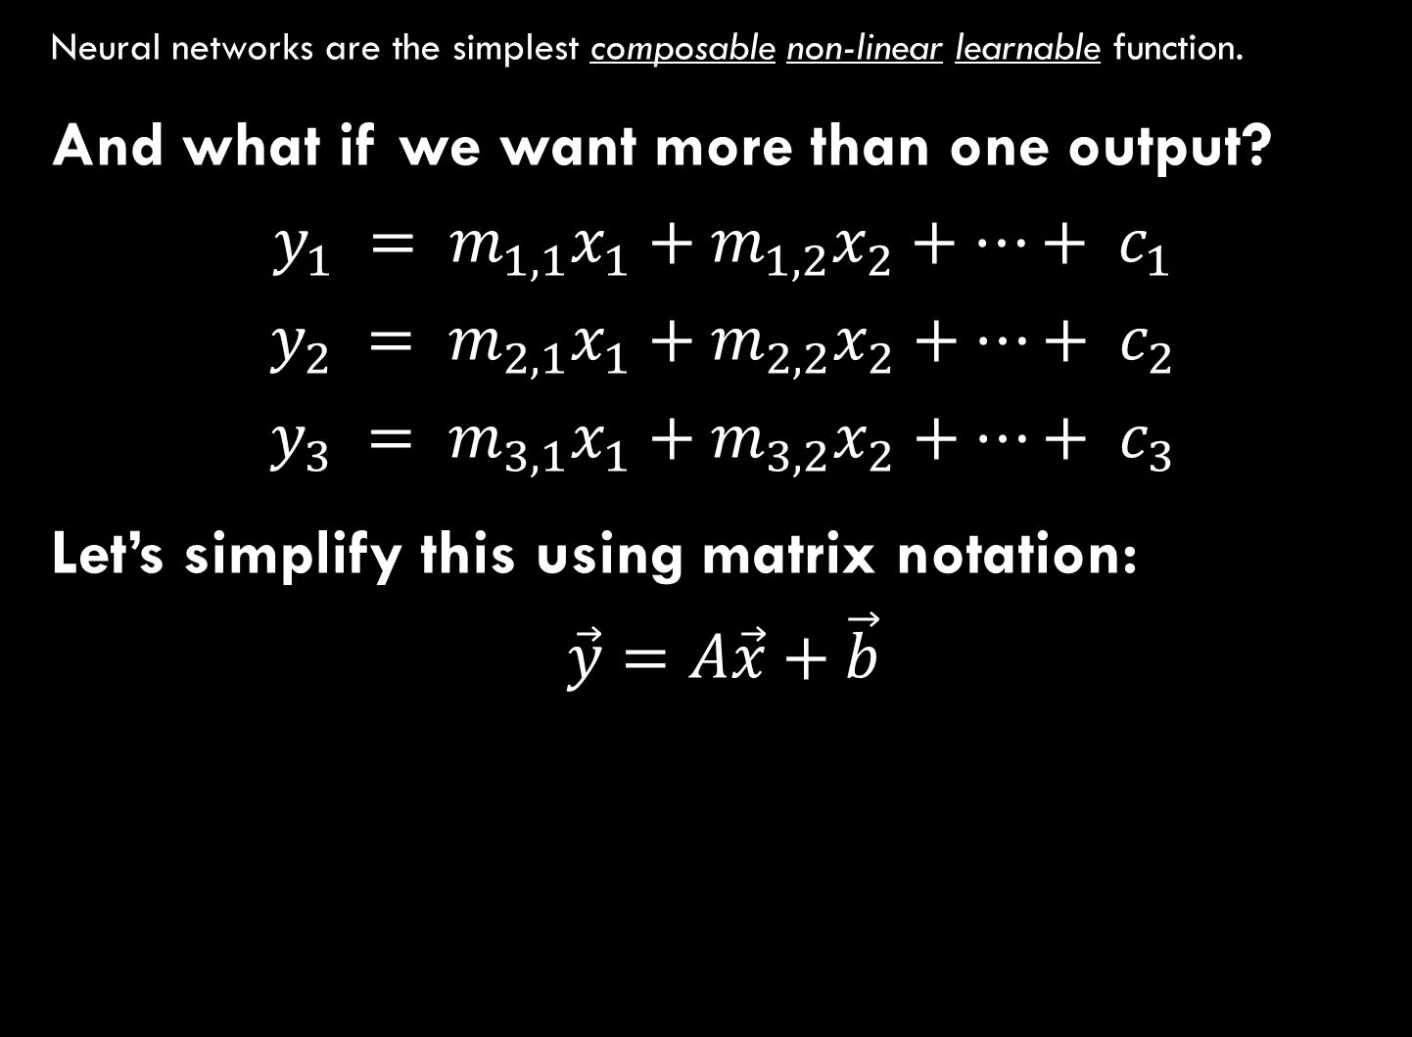



Neural networks are the simplest composable non-linear learnable function.
And what if we want more than one output?
$$y_{1} = m_{1,1}x_{1}+m_{1,2}x_{2}+…+ c_{1}$$
$$y_{2} = m_{2,1}x_{1}+m_{2,2}x_{2}+…+ c_{2}$$
$$y_{3} = m_{3,1}x_{1}+m_{3,2}x_{2}+…+ c_{3}$$
Let’s simplify this using matrix notation:
$$\vec{y}=A\vec{x}+\vec{b}$$
$$ℝ^{|out|}$$
$$ℝ^{|out|}$$
$$ℝ^{\left|out\right|×|in|}$$
$$ℝ^{|in|}$$

Slide 10
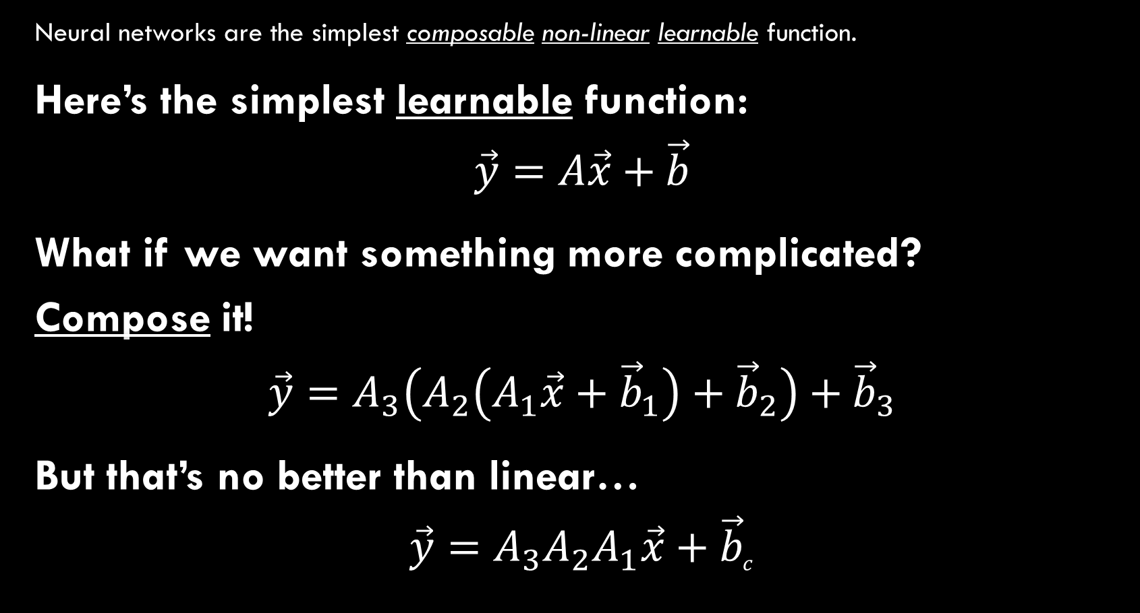
Neural networks are the simplest composable non-linear learnable function.
Here’s the simplest learnable function:
$$\vec{y}=A\vec{x}+\vec{b}$$
What if we want something more complicated? Compose it!
$$\vec{y}=A_{3}\left(A_{2}\left(A_{1}\vec{x}+{\vec{b}}_{1}\right)+{\vec{b}}_{2}\right)+{\vec{b}}_{3}$$
But that’s no better than linear…
$$\vec{y}=A_{3}A_{2}A_{1}\vec{x}+{\vec{b}}_{c}$$

Slide 11









Neural networks are the simplest composable non-linear learnable function.
Here’s the simplest learnable function:
$$\vec{y}=A\vec{x}+\vec{b}$$
What if we want something more complicated? Compose it!
$$\vec{y}=A_{3}\left(A_{2}\left(A_{1}\vec{x}+{\vec{b}}_{1}\right)+{\vec{b}}_{2}\right)+{\vec{b}}_{3}$$
But that’s no better than linear…
$$\vec{y}=A_{3}A_{2}A_{1}\vec{x}+{\vec{b}}_{c}$$
Why are stacked linear functions always linear?
Linear operations are equivalent to a shift-and-rotation.
You can’t shift-and-rotate a line into a different shape
$$y$$
$$y$$
$$y$$
$$x$$
$$x$$
$$x$$
$$y$$
$$x$$

Slide 12







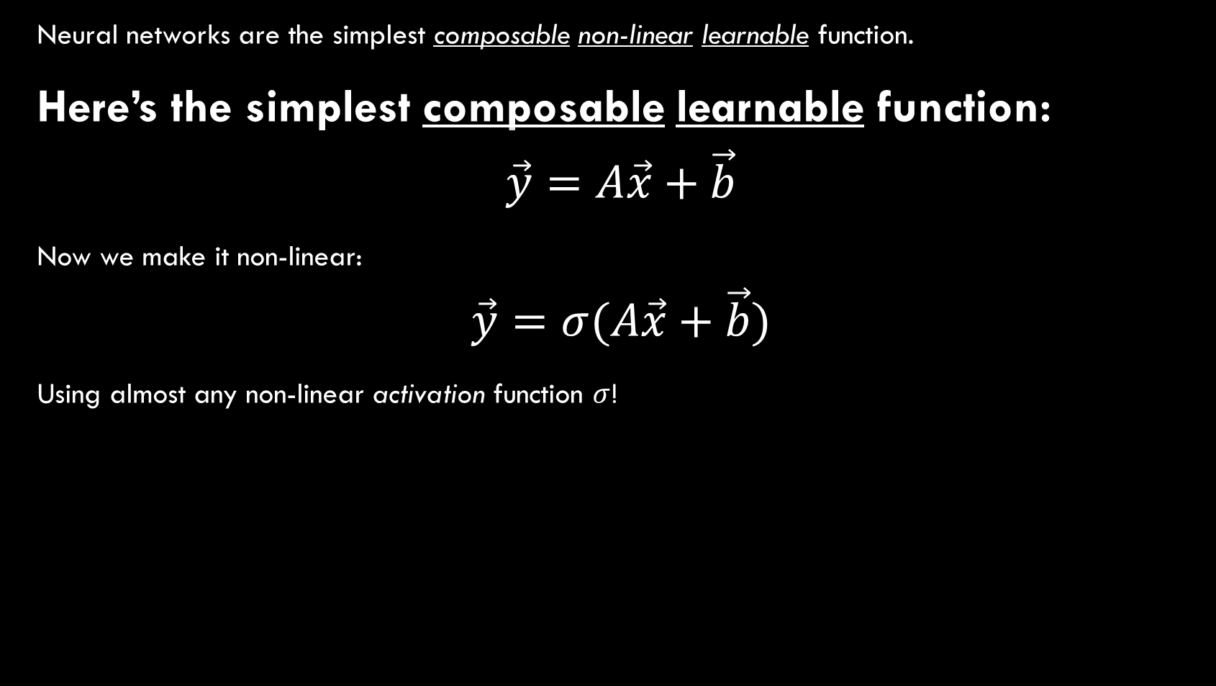

Neural networks are the simplest composable non-linear learnable function.
Here’s the simplest composable learnable function:
$$\vec{y}=A\vec{x}+\vec{b}$$
Now we make it non-linear:
$$\vec{y}=σ(A\vec{x}+\vec{b})$$
Using almost any non-linear activation function $σ$!
$$ReLU(x)$$
$$Sigmoid(x)$$
$$x^{2}$$
$$Swish(x)$$
$$x$$
$$x$$
$$x$$
$$x$$

Slide 13
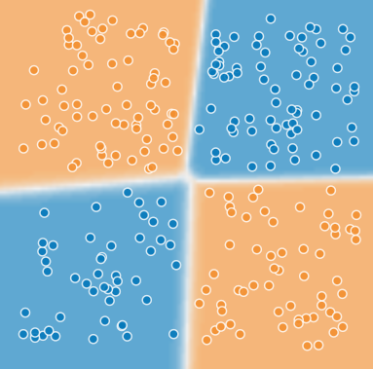
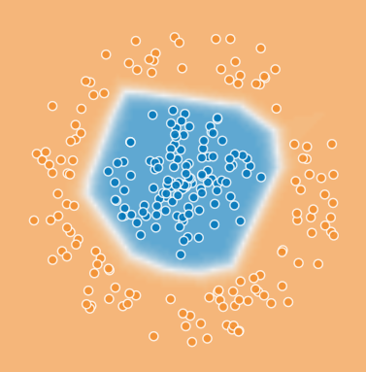
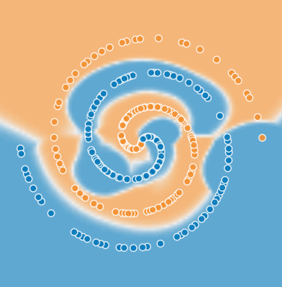

Neural networks are the simplest composable non-linear learnable function.
$$\vec{y}=A_{3} σ\left(A_{2} σ\left(A_{1}\vec{x}+{\vec{b}}_{1}\right)+{\vec{b}}_{2}\right)+{\vec{b}}_{3}$$
…and now we can learn anything^{[T&C Apply]} with them!
Dots are training data; background is learned function.
(Check out playground.tensorflow.org)

Slide 14
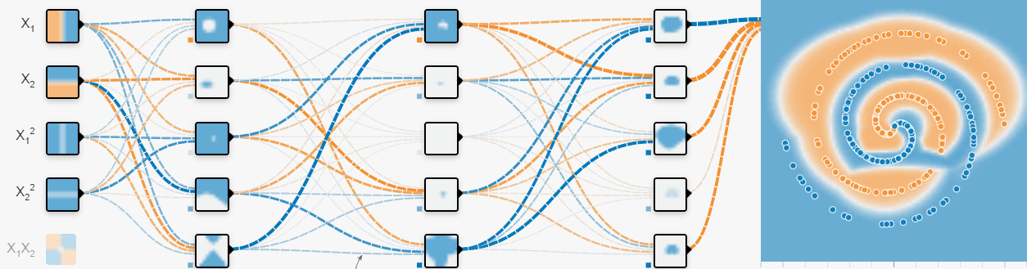

Neural networks are the simplest composable non-linear learnable function.
$$\vec{y}=A_{3} σ\left(A_{2} σ\left(A_{1}\vec{x}+{\vec{b}}_{1}\right)+{\vec{b}}_{2}\right)+{\vec{b}}_{3}$$

Slide 15


Neural networks are the simplest composable non-linear learnable function.
$$\vec{y}=A_{3} σ\left(A_{2} σ\left(A_{1}\vec{x}+{\vec{b}}_{1}\right)+{\vec{b}}_{2}\right)+{\vec{b}}_{3}$$
We find $A_{1}, {\vec{b}}_{1},A_{2},{\vec{b}}_{2},…$using backpropagation:
(Assuming the layers are differentiable)
Recommended Video!
Differentiate using the chain rule
Notes:
Recommended video: https://www.youtube.com/watch?v=wvWpdrfoEv0

Slide 16
do we Use Neural Networks?
How

Slide 17



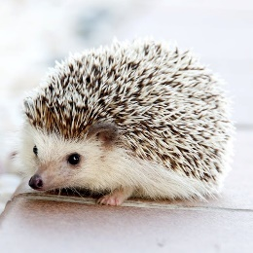

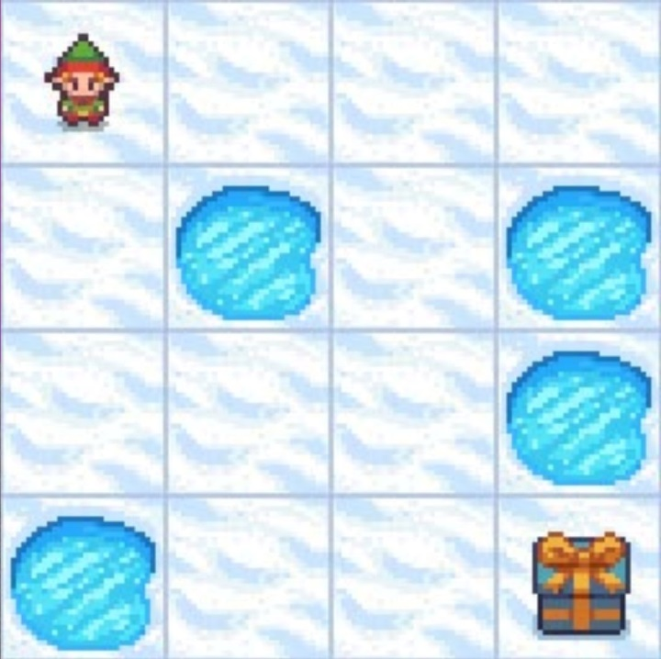




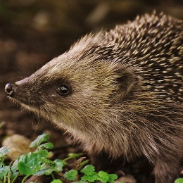
3 Kinds of ML
Dog
Cat
Dog
Cat
Dog
Cat
Supervised Learning
Unsupervised Learning
Reinforcement Learning
Image: https://simoninithomas.github.io/deep-rl-course/

Slide 18
Supervised Learning
Dog
Cat
Dog
Cat
Dog
Cat

Slide 19
Unsupervised Learning
Notes:
Used because labels are more expensive than data, particularly for medical images.

Slide 20
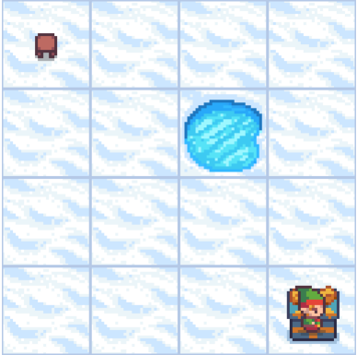
Reinforcement Learning
FrozenLake-v0 Map
Learned Policy and Value Function
Image: https://gymnasium.farama.org/tutorials/training_agents/FrozenLake_tuto/
Notes:
This is interactive, the others are fixed.

Slide 21
Should we use them?
When

Slide 22
Neural networks are… | Neural networks are not…
able to generalize from known examples to new ones | able to reason or deduce from fixed laws able to guarantee error bounds on predictions
great for data with an unknown but complex structure | great for data with known distributions or features
reliant on good model design | easy to verify your model design

Slide 23
The most dangerous thing to have is an opinion. Here’s mine:
Use neural networks for tasks that you do instinctively or subconsciously.
Don’t use neural networks for tasks that require:
reasoning about things
high confidence in predictions
working across multiple levels of abstraction
Whenever possible break tasks into sub-tasks and stitch them together.
You can sometimes break some of these rules… …with enough data and compute. …with the right network design …but you won’t know if you can until you try.
Type-I tasks from Daniel Kahneman’s Thinking, Fast and Slow

Slide 24
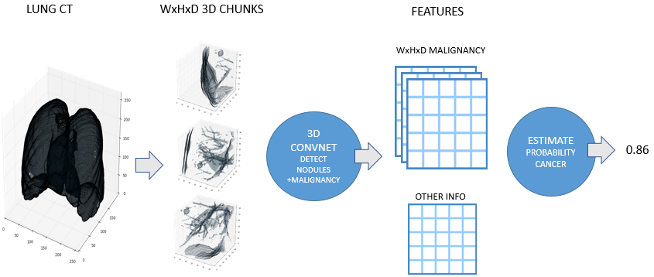
The importance of good structure: Kaggle 2017 Data Science Bowl – Lung Cancer Prediction
Malignancy
Diameter
Spiculation
Nodule Prediction
Lobulation
etc.
…
Nodule Prediction
Lung Cancer Score
…
Nodule Prediction

Slide 25
Could possibly go wrong?
What
(A whole lot, it turns out.)

Slide 26



Problem: Model-Data Mismatch
What if your model can’t represent your data?
$$y$$
$$y$$
$$y$$
$$x$$
$$x$$
$$x$$
The data is generated using a parabola + jitter. Fitting the data to a parabola recovers it well.
A line can’t represent the data well.
This is underfitting.
A richer function class fits the data exactly but performs poorly everywhere else. This is overfitting.

Slide 27
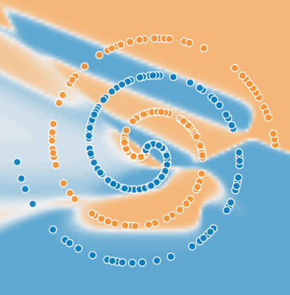
Problem: Model-Data Mismatch
What if your model can’t represent your data?
In practice, it looks like this:

Slide 28
These are model capacity problems
Capacity is the complexity of the function an NN can represent.
The problem is much harder in practice – you don’t know how what the underlying function is.
Symptoms of bad NN design
Change the design,
Try adding regularization, or
Make the architecture more task-specific.
The Caltech ML MOOC explains the theory very well!
In some contexts, regularization can make things much worse.
Ask me about my research!
Course: https://work.caltech.edu/telecourse.html#lectures

Slide 29
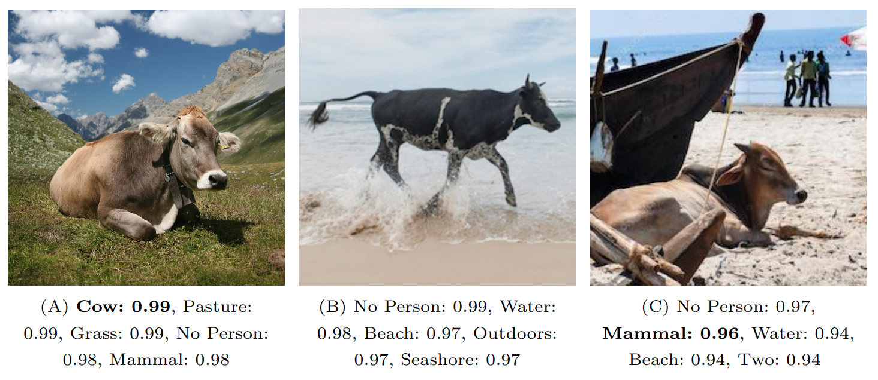
Problem: Spurious Correlation
Cows are only recognized in “cow-like” contexts.
Recognition in Terra Incognita (Beery et al, 2018)

Slide 30
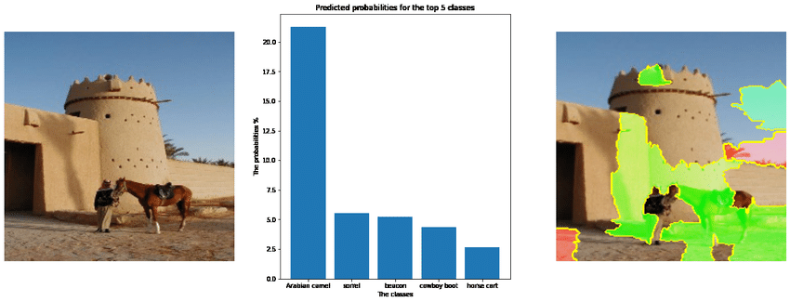
Problem: Spurious Correlation
The horse is mistaken for a camel because of the sandy background.
Arabian Camel
Horse Cart
Beacon
Cowboy Boot
Sorrel
Adversarial Reconstruction Loss for Domain Generalization (Bekkouch et al, 2021)

Slide 31
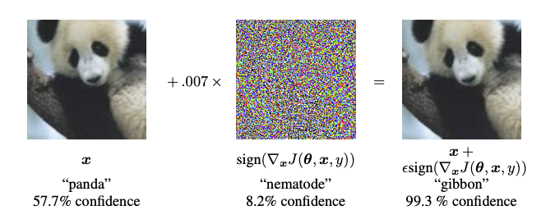
Problem: Adversarial Examples
Explaining and Harnessing Adversarial Examples (Goodfellow et al, 2015)

Slide 32
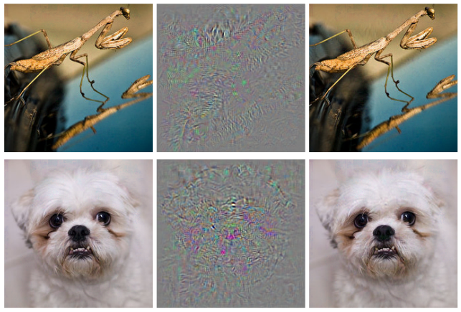
Problem: Adversarial Examples
Mantis
Ostrich
Dog
Ostrich
X 0.007
Intriguing properties of neural networks (Szegedy et al, 2013)

Slide 33
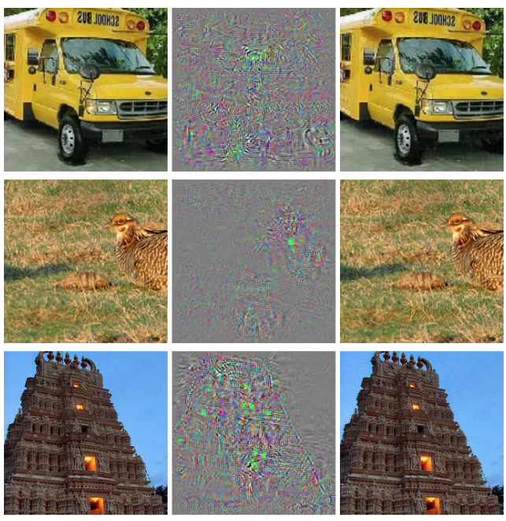
Problem: Adversarial Examples
School Bus
Ostrich
Temple
Ostrich
Intriguing properties of neural networks (Szegedy et al, 2013)

Slide 34
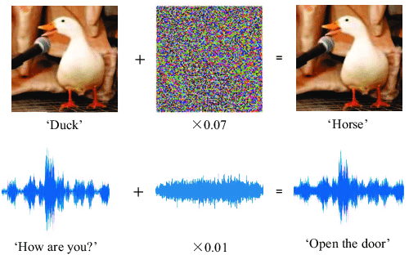
Problem: Adversarial Examples
Protecting Voice Controlled Systems Using Sound Source Identification Based on Acoustic Cues (Gong et al, 2018)

Slide 35

How to talk to your cat about
Deep Learning
Gaurav Manek LKC Lab, IMCB

Slide 36
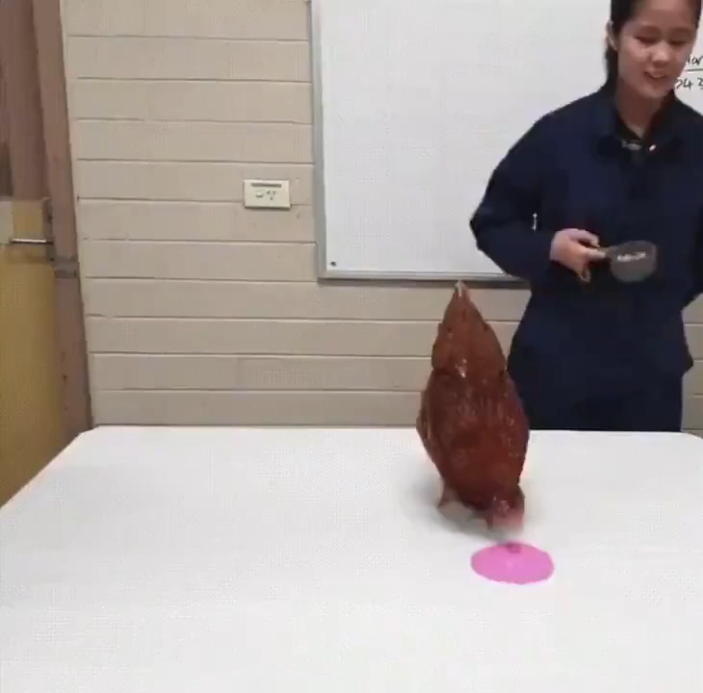
Reinforcement Learning on a chicken!

