Slide 1

early-stage startups
Dr Gaurav Manek
gaurav@gauravmanek.com
DECISION-MAKING IN

Slide 2
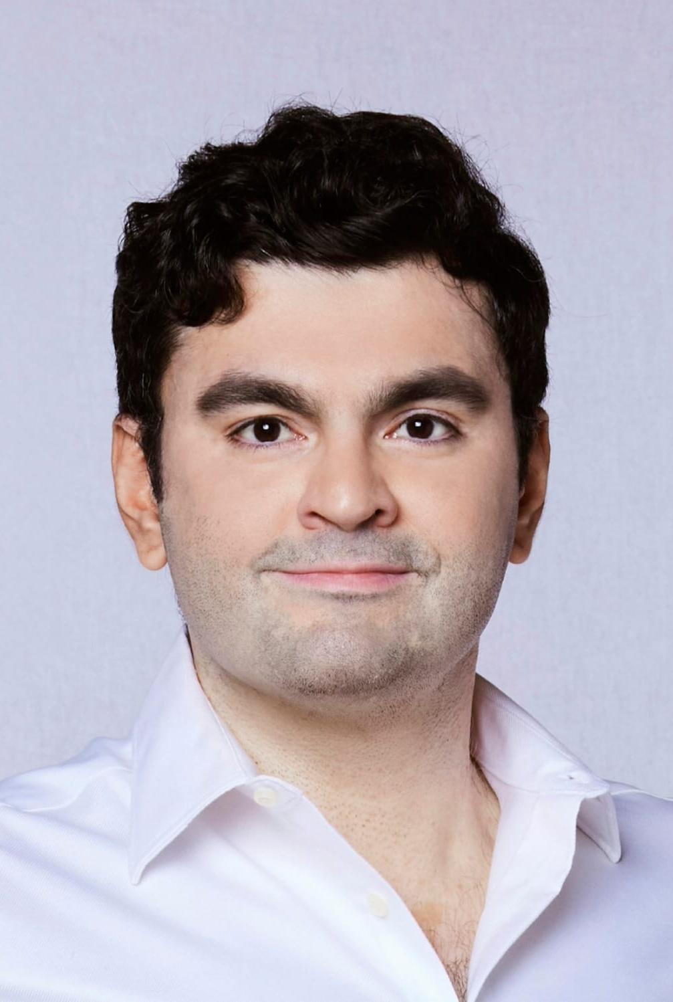
Dr Gaurav Manek
Founder: SaaS Startup Visigoth.ai
Scientist: IMCB, A*STAR
Founder: Ocellivision, A*STAR
PhD in AI/ML from Carnegie—Mellon
Sc.B. (Hons) in CS from Brown
Opinions here are not my employers’
For consulting: gaurav@gauravmanek.com

Slide 3
Agenda
Part 1: Starting up a Company
Startups tend to fail
Stages of starting up
Great filters
Exit plan
Part 2: Case Studies
Bad ideas
Fundraising
Customer Discovery
Early Growth
Maturity
Part 3: In Summary
Collected Advice
Should I build a startup?
(This is an abridged lecture, omitting issues specific to SaaS and AI startups.)

Slide 4
Starting up a company
Starting a company is like staring into the abyss and eating glass.
— Elon Musk

Slide 5
Startups tend to Fail
1 year | 20%
3 years | 39%
5 years | 50%
10 years | 65%
38% | Financial Issues
35% | Lack of Market Need
20% | Competition
19% | Business Model
18% | Legal Challenges
because
Numbers from the US. See https://www.forbes.com/advisor/business/software/startups-failure-rate/

Slide 6
Stages of starting up
Idea
Prototyping
Go-to-market
Early Growth
Growth
Maturity
Notes:
Idea
You have an idea, and you’re convinced that it solves a problem for someone in a way that they will pay you for.
Prototyping
You build the coarsest possible version of your solution, held together with spit and duct tape.
Go-to-market
You receive money from a few people for your solution.
Early Growth
You start making predictable sales.
Growth
You make more and more sales, and expand across markets.
Maturity
You attain stable, average, growth and now work to maintain market position.
We’re going to focus on the first half.

Slide 7
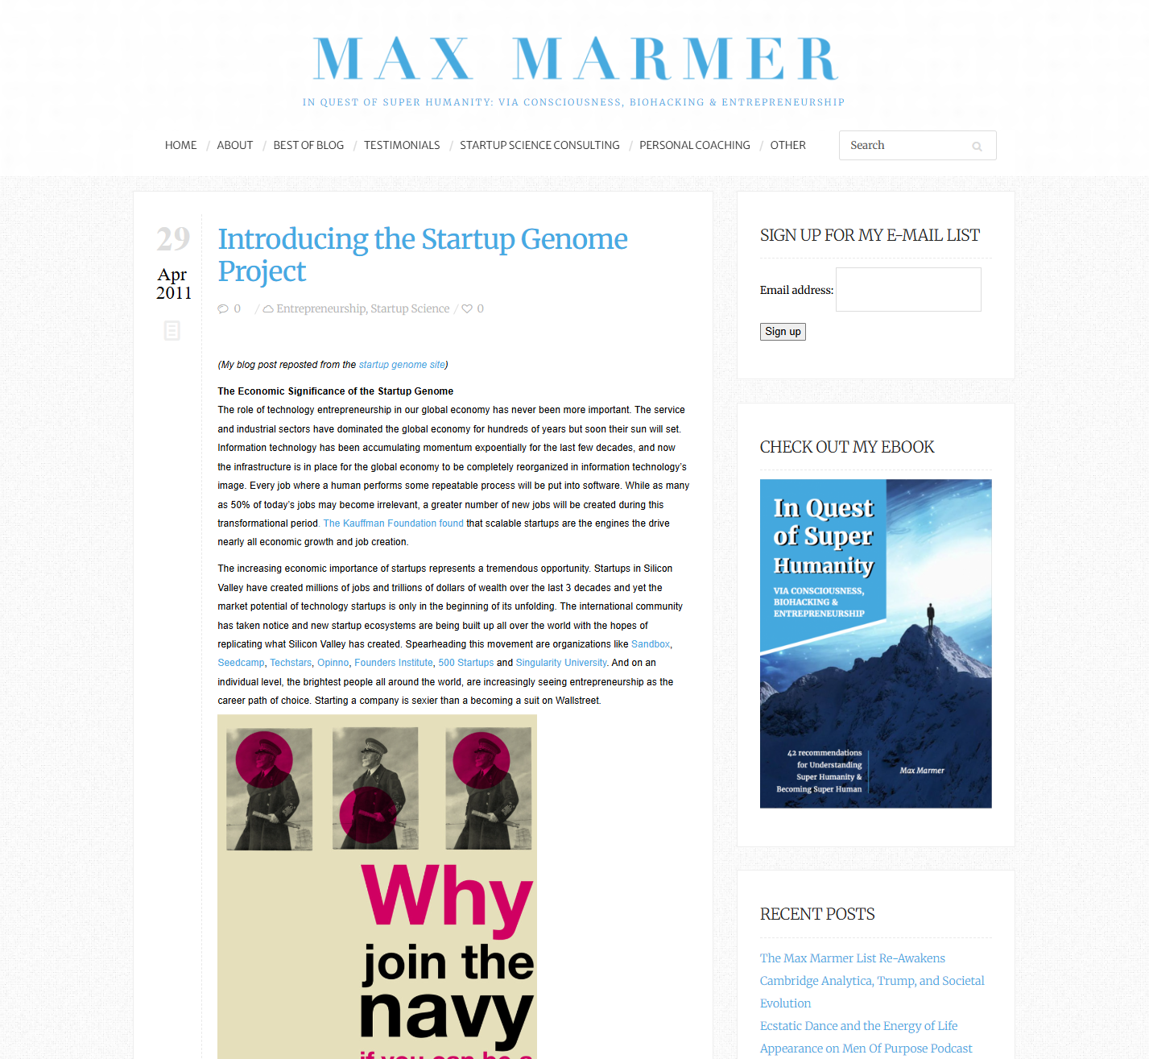
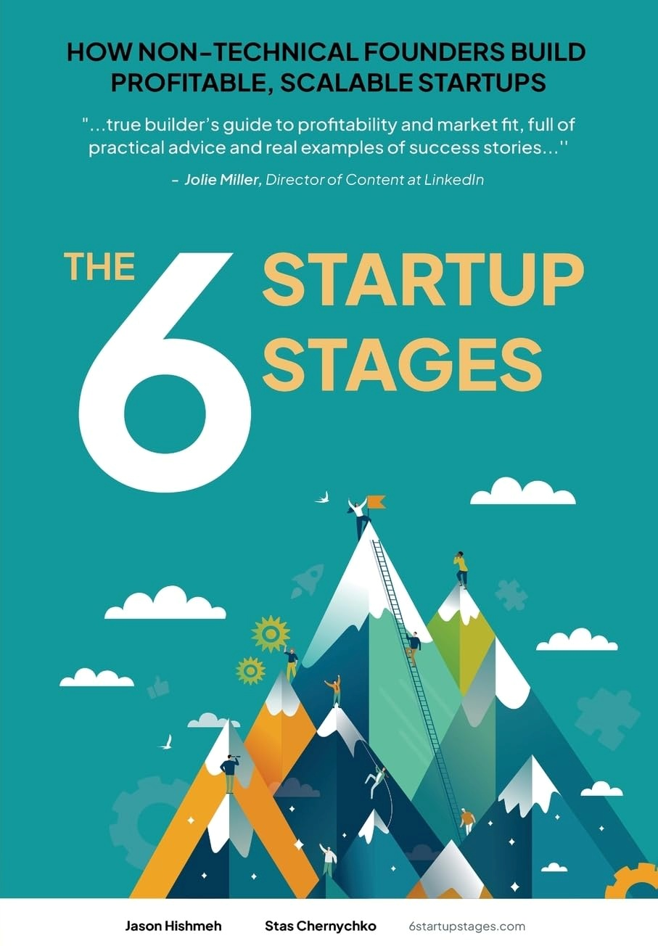
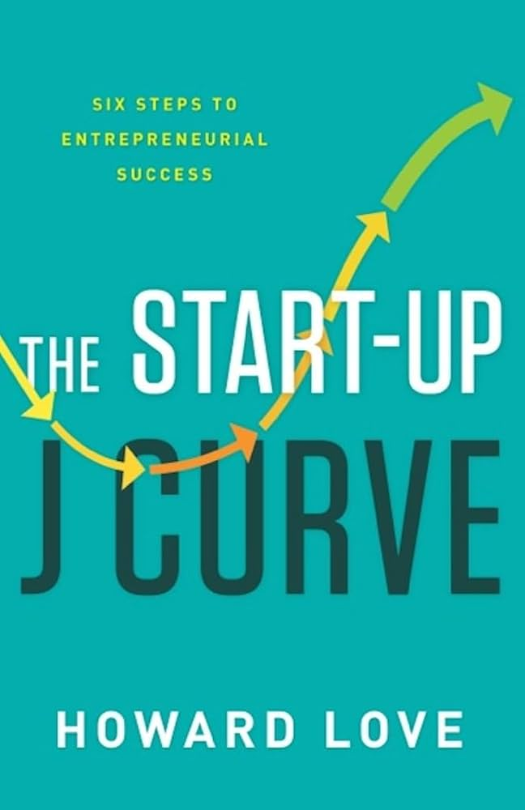
Stages of starting up
Idea
Prototyping
Go-to-market
Early Growth
Growth
Maturity
Notes:
Every VC has their own version of this. It seems to have come from some work by a serial entrepreneur and VC. The best reference for this is a book released last year.

Slide 8
Phases of Starting Up
Idea
Prototyping
Go-to-market
Early Growth
Growth
Maturity
Revenue Generating
The funding gap is an existential threat for all startups.
Manage your runway, control your burn rate.
Notes:
At what stage are you revenue generating?

Slide 9
Phases of starting up
Idea
Prototyping
Go-to-market
Early Growth
Growth
Maturity
Do you sell anything?
Revenue Generating
Where does your money come from?
How much equity do you give up?
Pre-Seed or F/F/F
Seed
Series A
Series B…
IPO
How big is the firm?
1—5 | 3—15 | 15—50 | 50—100 | 100—1000

Slide 10
Equity in a startup
Idea
Prototyping
Go-to-market
Early Growth
Growth
Maturity
Where does your money come from?
How much equity do you give up?
Pre-Seed or F/F/F: 10%
Seed: 20%
Series A: 25%
Series B…
IPO
You can dilute your share to nothing very easily.
You can agree to innocuous terms that are very bad later.
You are usually at an information disadvantage about external issues.
Notes:
Innocuous terms: Convertible debt

Slide 11
The Great Filters
Idea
Prototyping
Go-to-market
Early Growth
Growth
Maturity
Validation
Is the problem worth solving? Does it solve the problem? Can you collect money?

Slide 12
The Great Filters
Idea
Prototyping
Go-to-market
Early Growth
Growth
Maturity
Validation | Customer Discovery
Is the problem worth solving? Does it solve the problem? Can you collect money? | Will someone actually pay? Can someone pay for it? (The M.A.N.) Other than the product, what do you need? Will your team fall apart?

Slide 13
The Great Filters
Idea
Prototyping
Go-to-market
Early Growth
Growth
Maturity
Validation | Customer Discovery | Product-Market Fit
Is the problem worth solving? Does it solve the problem? Can you collect money? | Will someone actually pay? Can someone pay for it? (The M.A.N.) Other than the product, what do you need? Will your team fall apart? | Do enough people have the same problem to pay for it? Are you able to consistently sell? What minor changes can I make to sell more?

Slide 14
The Great Filters
Idea
Prototyping
Go-to-market
Early Growth
Growth
Maturity
Validation | Customer Discovery | Product-Market Fit | Expanding Everything
Is the problem worth solving? Does it solve the problem? Can you collect money? | Will someone actually pay? Can someone pay for it? (The M.A.N.) Other than the product, what do you need? Will your team fall apart? | Do enough people have the same problem to pay for it? Are you able to consistently sell? What minor changes can I make to sell more? | How to build sales channels and marketing? How to scale production, operations, and distribution? How to set prices?

Slide 15
The Great Filters
Idea
Prototyping
Go-to-market
Early Growth
Growth
Maturity
Validation | Customer Discovery | Product-Market Fit | Expanding Everything | Market Segments
Is the problem worth solving? Does it solve the problem? Can you collect money? | Will someone actually pay? Can someone pay for it? (The M.A.N.) Other than the product, what do you need? Will your team fall apart? | Do enough people have the same problem to pay for it? Are you able to consistently sell? What minor changes can I make to sell more? | How to build sales channels and marketing? How to scale production, operations, and distribution? How to set prices? | How to add new market segments? (The bowling alley model)

Slide 16
The Great Filters
Idea
Prototyping
Go-to-market
Early Growth
Growth
Maturity
Validation | Customer Discovery | Product-Market Fit | Expanding Everything | Market Segments | Defending Position
Is the problem worth solving? Does it solve the problem? Can you collect money? | Will someone actually pay? Can someone pay for it? (The M.A.N.) Other than the product, what do you need? Will your team fall apart? | Do enough people have the same problem to pay for it? Are you able to consistently sell? What minor changes can I make to sell more? | How to build sales channels and marketing? How to scale production, operations, and distribution? How to set prices? | How to add new market segments? (The bowling alley model) | How to grow at CAGR? How to avoid complacency? How to defend against large players? How not to be disrupted? How to create shareholder value?

Slide 17
The Exit Plan
Idea
Prototyping
Go-to-market
Early Growth
Growth
Maturity

Slide 18
The Exit Plan
Idea
Prototyping
Go-to-market
Early Growth
Growth
Maturity
Sell IP | Sell IP | Sell IP |  | IPO

Slide 19
The Exit Plan
Idea
Prototyping
Go-to-market
Early Growth
Growth
Maturity
Sell IP | Sell IP | Sell IP |  | IPO
 | Hired by competitor | Hired by competitor
Notes:
Hired by competitor is not as benign as you’d like: poaching of individuals, exploding offers, etc. are all common. Example: Meta hiring OpenAI talent for $200mn/yr, Sam Altman makes <$80mn/yr.

Slide 20
The Exit Plan
Idea
Prototyping
Go-to-market
Early Growth
Growth
Maturity
Sell IP | Sell IP | Sell IP |  | IPO
 | Hired by competitor | Hired by competitor | Bought out by majority shareholders. | Bought out by majority shareholders.
Notes:
Hired by competitor is not as benign as you’d like: poaching of individuals, exploding offers, etc. are all common. Example: Meta hiring OpenAI talent for $200mn/yr, Sam Altman makes <$80mn/yr.
Bought out by majority shareholders: usually acrimonious. Subnautica 2?

Slide 21
The Exit Plan
Idea
Prototyping
Go-to-market
Early Growth
Growth
Maturity
Sell IP | Sell IP | Sell IP |  | IPO
 | Hired by competitor | Hired by competitor | Bought out by majority shareholders. | Bought out by majority shareholders.
 |  | M&A | M&A | M&A
Notes:
Acquisition is rarely done for cash, almost always a “stock swap”.

Slide 22
The Exit Plan
Idea
Prototyping
Go-to-market
Early Growth
Growth
Maturity
Sell IP | Sell IP | Sell IP |  | IPO
 | Hired by competitor | Hired by competitor | Bought out by majority shareholders. | Bought out by majority shareholders.
 |  | M&A | M&A | M&A
 |  |  |  | Dividends
 |  |  |  | Bought out by private equity.
“Take-along” and “Drag-along” clauses
Notes:
Take-along and drag-along clause in private equity purchase.

Slide 23
The Exit Plan
Idea
Prototyping
Go-to-market
Early Growth
Growth
Maturity
Sell IP | Sell IP | Sell IP |  | IPO
 | Hired by competitor | Hired by competitor | Bought out by majority shareholders. | Bought out by majority shareholders.
 |  | M&A | M&A | M&A
 |  |  |  | Dividends
 |  |  |  | Bought out by private equity.
“Take-along” and “Drag-along” clauses
Notes:
Hired by competitor is not as benign as you’d like: poaching of individuals, exploding offers, etc. are all common. Example: Meta hiring OpenAI talent for $200mn/yr, Sam Altman makes <$80mn/yr.
Acquisition is rarely done for cash, almost always a “stock swap”.
Bought out by majority shareholders: usually acrimonious. Subnautica 2?
Take-along and drag-along clause in private equity purchase.

Slide 24
Fundraising
Why?
Idea
Prototyping
Go-to-market
Early Growth
Growth
Maturity
Revenue Generating
The funding gap is an existential threat for all startups.
Manage your runway, control your burn rate.
Growth-stage companies tend to raise funds for growth instead of using revenue.
Why?
Notes:
Growth
Because if you have an opportunity to scale that produces better returns than the interest rate, that its almost always transient. So it is better to borrow the money and do it quickly than to do it slowly.
Mature
Why do mature companies borrow? What do they do with the money? Vertical integration, horizontal integration.
Common to buy suppliers of key factors of production: e.g. Apple buying Dialog Semicon (70% of sales to Apple) for power management. Common to buy to get access to key production Amazon acquiring Kiva Systems.
Sometimes, customer acquisition is expensive because of the business, the longevity of the product, or because of network effects. Ex: Facebook buying Instagram, Unilever buying Dollar Shave Club.

Slide 25
Employees vs Founders
Employees | Founders
Fulfil a specific role. | Fulfil all roles at the same time
Responsible to manager. | Responsible to self, and maybe shareholders
Constrained by company’s internal limits and resources. | Constrained by extrinsic factors, provides internal limits and resources.
Predictable income with low risk. | High financial risk for a long time.
Predictable career ladder. | No ladder – just your own rope.
Someone else’s vision | Your vision, your passion.

Slide 26
Case Studies
Success is a lousy teacher. It seduces smart people into thinking they can’t lose.”
– Bill Gates

Slide 27
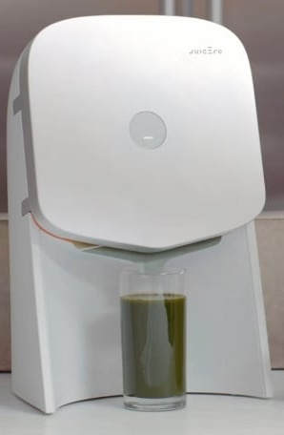
Filter: Idea Juicero
Machine that presses pre-made juices out of mylar packaging.
Sold machine for US$400, juice pack for $5—7.
DRM on juice pack so it would only squeeze original packs within their best-before date.

Slide 28
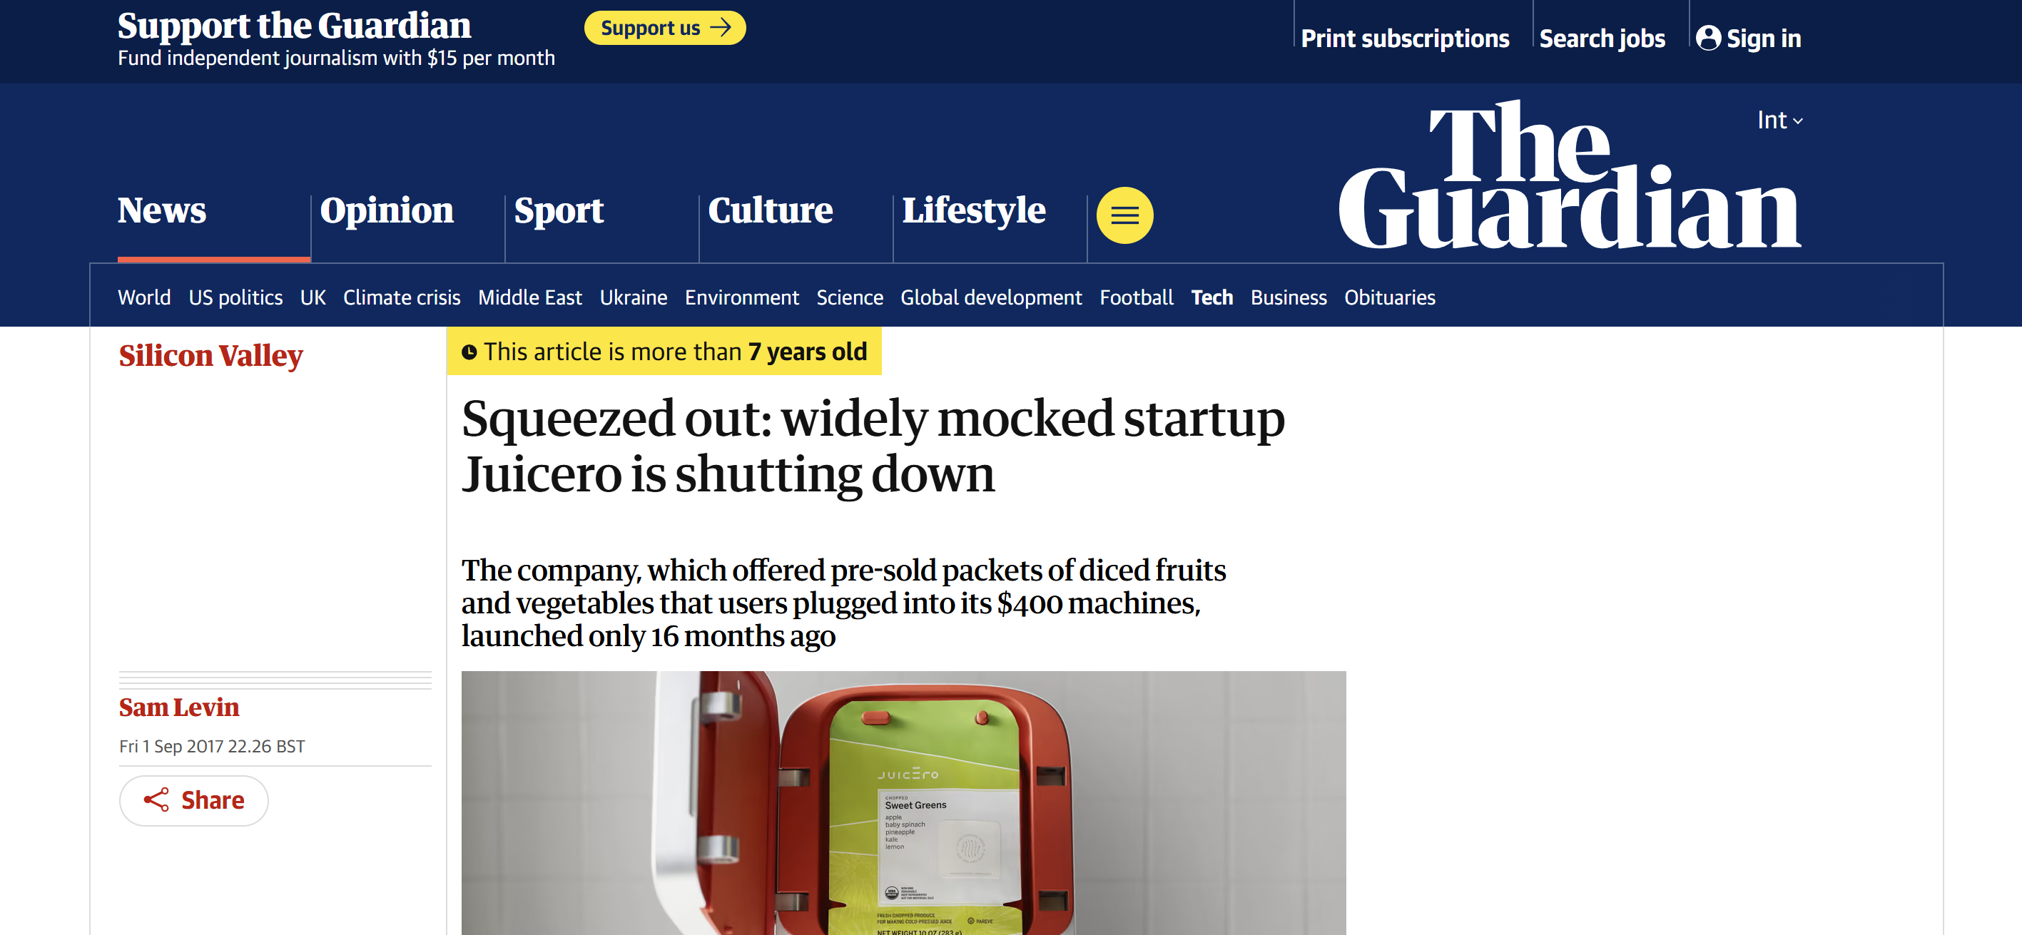
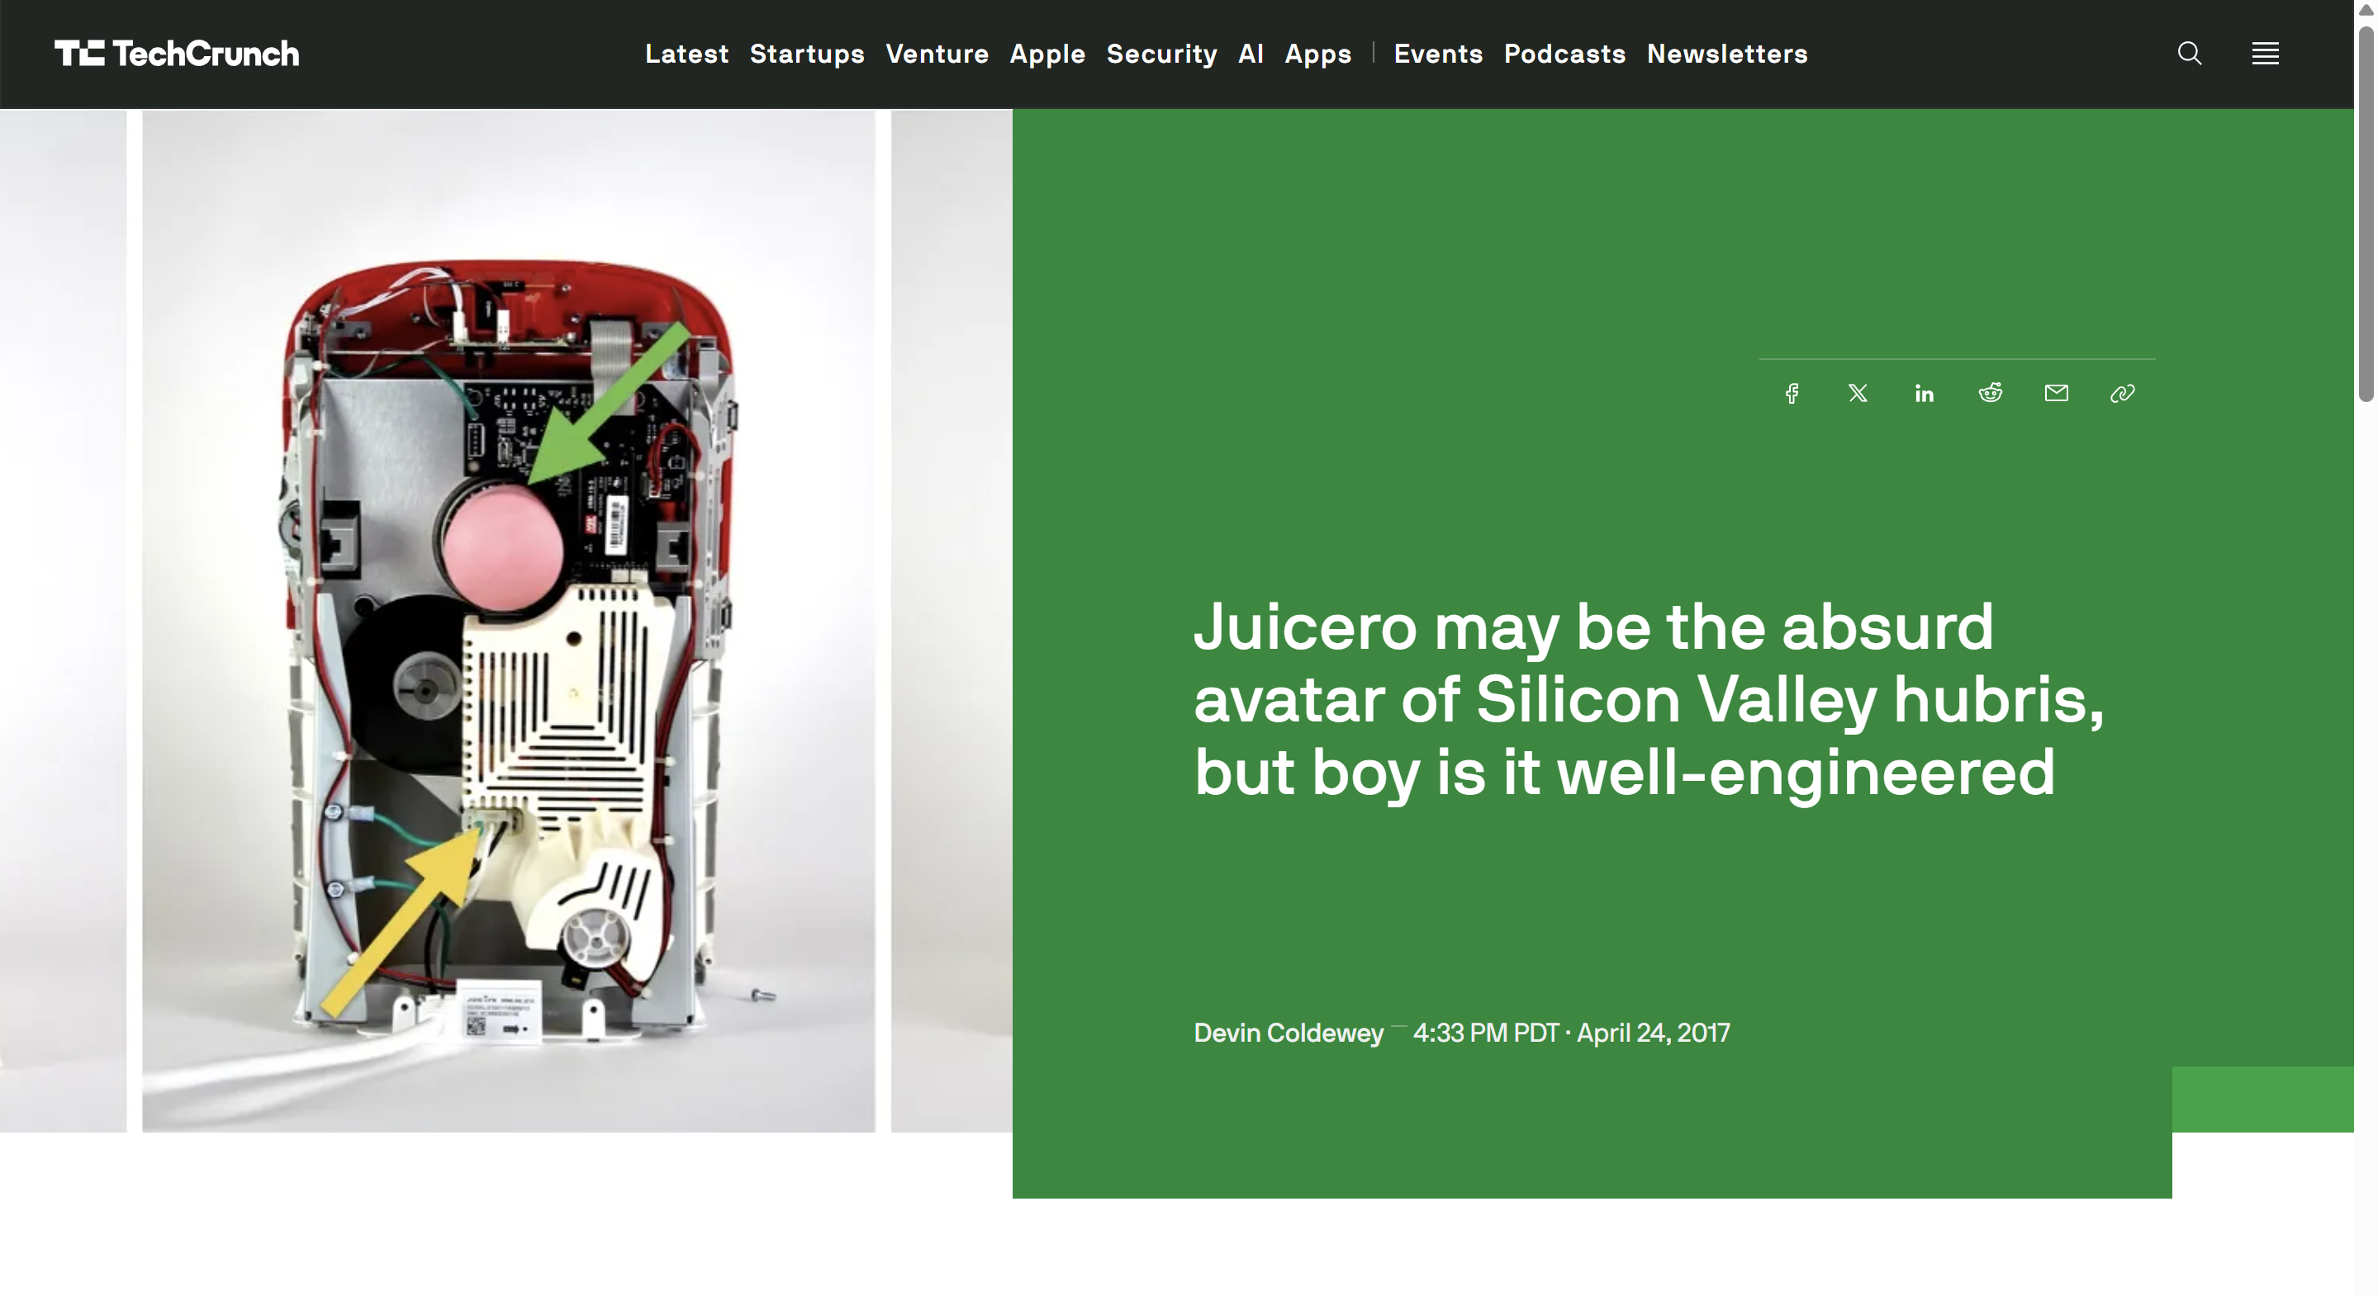
How did they raise $120M?

Slide 29
Fundraising What are investors looking for?
Investors raise pools of money and have 5—7 years to provide the best return.
Like what startup founders do, but at a much larger scale!
Provides pressure for investors to choose.
Investors generally optimize for what the next investor is looking for, not for eventual market success.
Prone to fads!
Avenue of exploitation → importance of Due Diligence.
Investors may know the market better than you, but you know your company better than them.
Notes:
Because of the investor cycle, investors will typically exit your company by selling to the next round of investors in their window. This is why investors raise money in rounds
Depending on the early stages of your company, you may be forced to look for an investor who has just closed a round and is looking for returns in seven years, not in a few years.

Slide 30
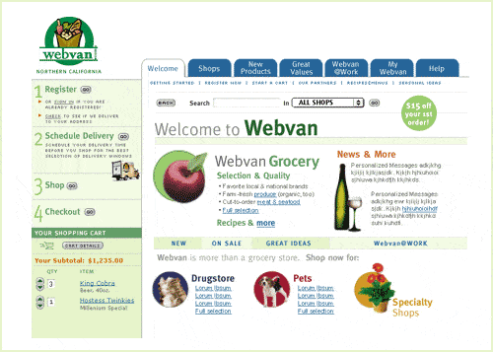
Filter: Customer Discovery WebVan
Original grocery delivery website in 1999. One of the most famous busts of the 2001 dotcom bubble.
Raised $396M from VCs and $375M in an IPO.
Why did they go bankrupt?
Notes:
Poor customer discovery: people had a ritual of going to buy groceries, and no trust or culture for online ordering products.
Poor investment: they invested in a giant robotic warehouse to reduce costs, but the investment amount was too high and the cost savings too low.
Poor burn rate management: they were losing $2M/day at the peak of their expenses. Grocery is a very small-margin business, and you need that.

Slide 31
Filter: Customer Discovery Clear and Unambiguous Failure
Clear and unambiguous failure is the best kind of failure. Alternatives:
You can be rejected by your customers.
MelaFind melanoma detection tool (MELA Sciences)
More sensitive than dermatologists, but less specific; distrusted in practice.
You can break the existing workflow.
NC-stat automated diabetic neuropathy device (NeuroMetrix)
Less work for similar accuracy but adds a delay between visit and diagnosis. Resisted by neurologists, indifferent primary care doctors.
You can be too novel for any existing workflow.
Aethlon Hemopurifier device scrubs viruses from your blood during dialysis.
Doctors have no usage standards; hospitals have no billing standards.
This is after spending tens of millions of dollars bringing an FDA-approved product to market.
Notes:
MelaFind melanoma detection tool (MELA Sciences)
More accurate than dermatologists, BUT—
Tends to be correct when dermatologists are wrong, and wrong when dermatologists are correct. (Greater sensitivity, but lower specificity.)
Bred distrust in dermatologists.
NC-stat automated diabetic neuropathy device (NeuroMetrix)
Less work for similar diagnosis accuracy, BUT—
Takes work and control away from neurologists and specialized technicians, and adds a delay between visit and diagnosis.
Resistance from neurologists and indifference from primary care doctors.
Aethlon Hemopurifier viral clearance device
Effectively scrubs viruses from your blood during dialysis, BUT—
Doctors have no standards on how to use it, hospitals have no standards on billing for it, and dialysis adds a lot of labor (especially in the ICU)
Currently looking for breakthrough in cancer treatment.

Slide 32
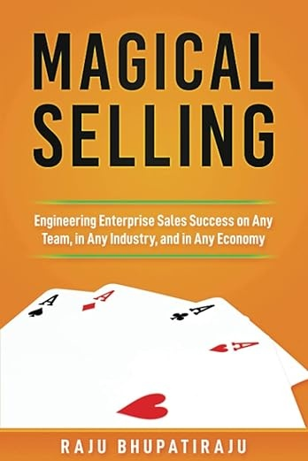
Money
Authority
Need
Every company separates these along the corporate hierarchy.
You must sell the same product in different ways to different people.
Notes:
Very rare to meet someone who has more than two of MAN.
For example, lets talk about selling a toy to a child. The child has the need, the parent has the money and authority. You sell it to the child as “fun”, and to the parent as “enriching”
Another example, lets talk about selling some database software to a company. The developer has the need, the tech lead or product manager has the authority, and the CFO has to sign off on the money.

Slide 33
Filter: Customer Discovery Example: Surgical Imaging System
Realtime tracking of brain tumour boundaries from imaging.
Money:
Hospital’s surgery department budget.
CAPEX is <$250k, approved by CFO.
Authority:
Chief of Surgery, input from chief of neuro.
Purchasing committee
Purchasing/legal department.
Need:
Neurosurgery team wants real-time tracking to improve margin clearance.
Hospital compliance team to meet accreditation requirements.

Slide 34
Filter: Customer Discovery Example: Sepsis Diagnostic Device
For quick use in emergency department.
Money:
Hospital’s laboratory equipment budget.
CAPEX is <$50k, approved by dept. head.
Authority:
Director of Pathology, input from Head of Emergency Medicine.
Purchasing/legal department.
Need:
ED physicians want faster sepsis diagnosis to start antibiotics earlier.
Pathology technicians are bottlenecked by running cell cultures to diagnose sepsis.

Slide 35
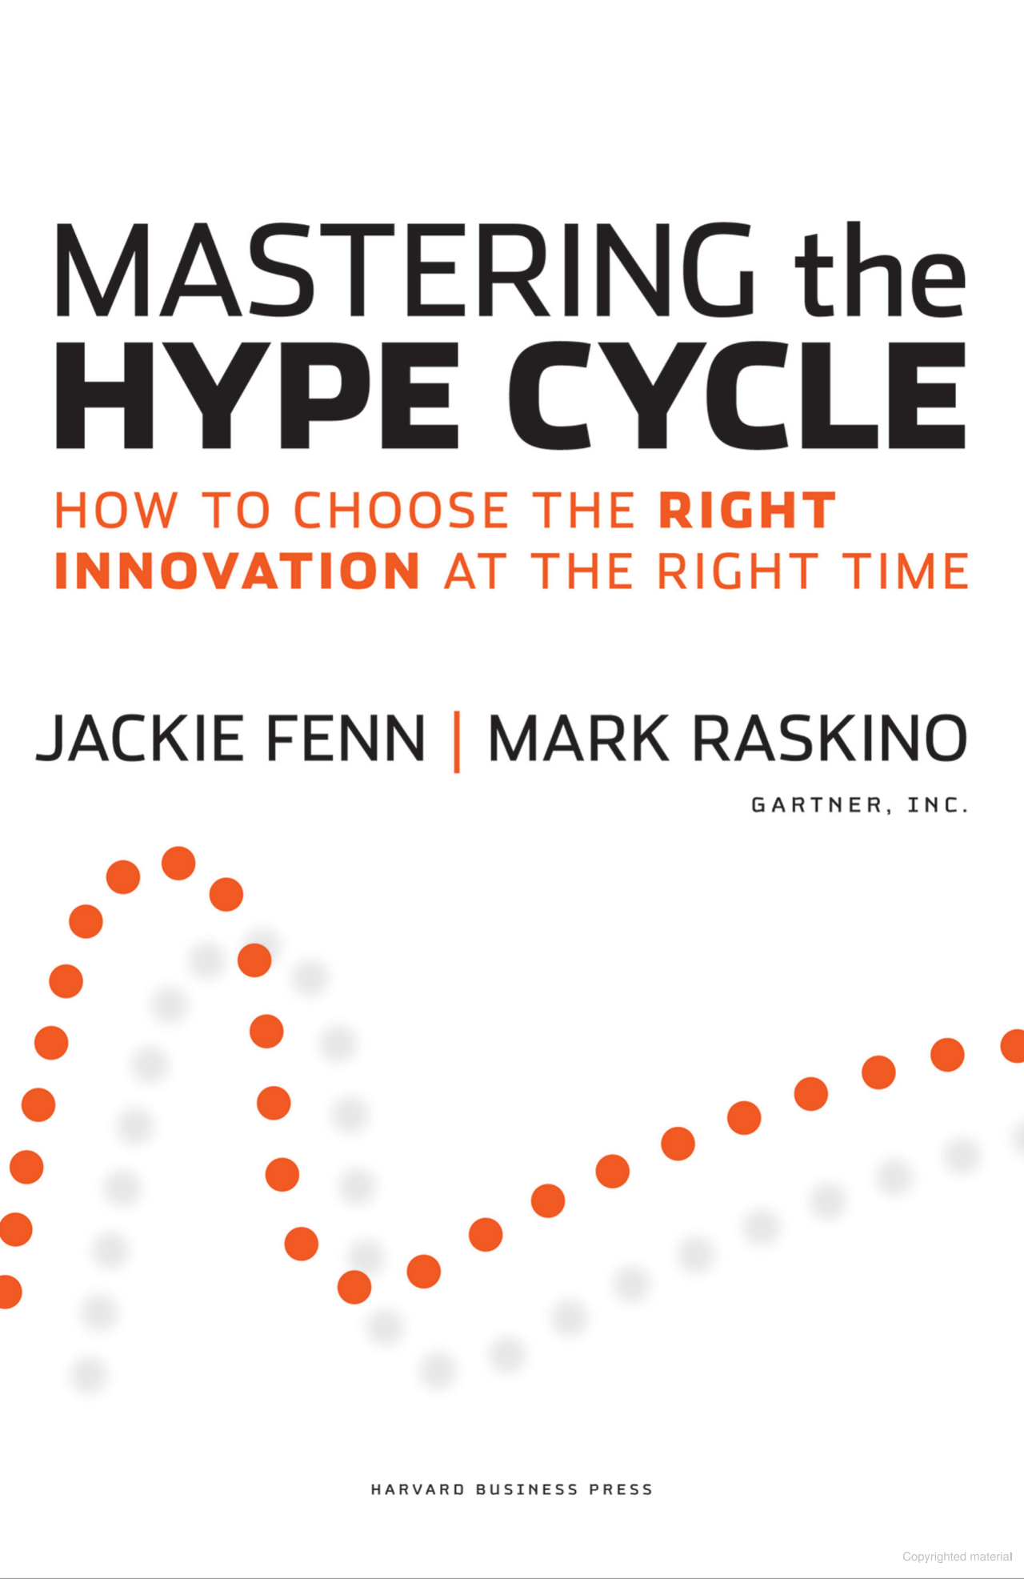
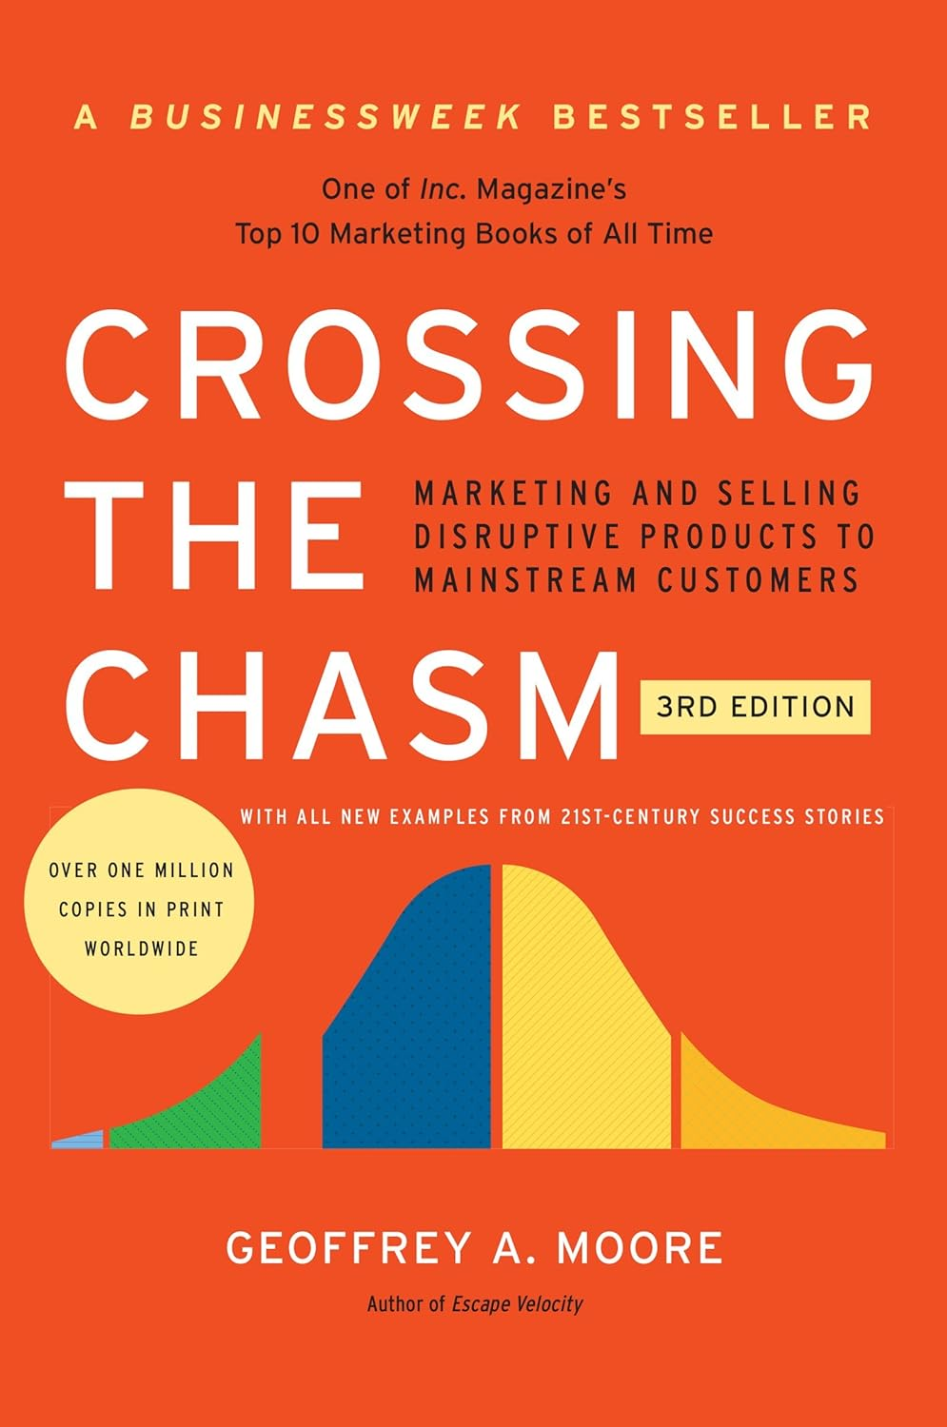
Filter: Customer Discovery

Slide 36
FILTER: Early Growth Why Do investors Like SaaS?
Idea
Prototyping
Go-to-market
Early Growth
Growth
Maturity
Because they can grow easily!
Why?
Because of IaaS/PaaS providers allow easy scaling.
Because modern toolchains encourage scalability-first principles.

Slide 37
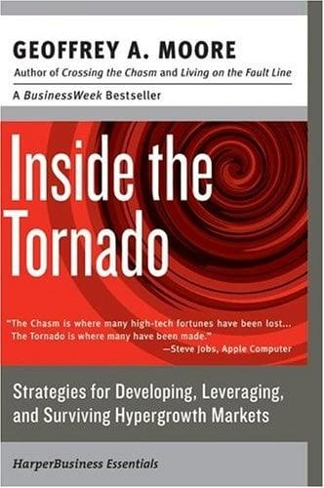
FILTER: Market Segments
The Bowling Alley Model
Begin by solving a specific problem for a specific market segment.
Once you have market dominance, you can add:
New market segment to the same population, or
Same market segment for a new population.
Limit your risk by only expanding one at a time!
Notes:
Market segment: specific, identifiable group of people with a specific need.
Facebook: thefacebook.com, Harvard, to universities, to everyone.
Netflix: DVD rental, internet video, producing own content.

Slide 38

FILTER: Maturity INCUMBENTS Get Disrupted
Google (by OpenAI)
Yahoo (by Google)
CompuServe, AOL, etc. (by Yahoo)
Blockbuster (by Netflix)
Kodak (by digital photography)
Nokia, Blackberry, Palm (by Apple, Google)
Encyclopaedia Britannica (by Wikipedia)
Toys R Us (by Amazon)
Garmin/TomTom (by Google Maps)
Sears (by Amazon)
Skype (by Zoom)
Yahoo Mail (by Gmail)
This is why mature companies invest in R&D and M&A.
Notes:
Anecdote about how (friend from Biotech company) was making weekly visits to hospitals in China

Slide 39
FILTER: Maturity Why Do We Care about CAGR?
CAGR = “Compound Annual Growth Rate”
Companies at maturity are collectively satisfying the total demand for the product in the entire market.
To generate more value, they must:
capture business from another company, or
make new business
Companies are locked in an eternal arms race with each other to maximize value, and they judge how well they’re doing it by how they grow relative to CAGR.
Notes:
Anecdote about how (friend from Biotech company) was making weekly visits to hospitals in China

Slide 40
In Summary

Slide 41
When working in a big company
Every big company you see was once a startup.
Some decisions made as a startup remain with a company.
Software architecture, regulatory pathway, business model.
Business relationships are enduring.
Market Position is an interactive game with others.
Notes:
Every big company you see was once a startup.
They had to navigate similar challenges in their time.
What seems obvious in retrospect never is in prospect.
Some decisions made as a startup remain with a company.
Software architecture, regulatory pathway, business model.
Business relationships are enduring.
Exclusive distributorship contracts.
Investments with right-of-first-refusal or other powers.
“Small” concession for a startup, outsize implication later.
Market Position is an interactive game with others.

Slide 42
When working in a startup
You must be exploiting some comparative advantage.
Protect your advantage
Legally through IP laws, Secrets, etc.
Talk to as many people as possible, especially customers.
Makes up for information disadvantage.
Correlate what people say.
Observe your customers solving their problem
Both with and without your product.
Notes:
Tell story of our product.

Slide 43
Which stages you see
Idea
Prototyping
Go-to-market
Early Growth
Growth
Maturity
As an employee.
As a founding employee (with equity).
As a consultant.
As an entrepreneur.

Slide 44
Should I build a startup?
Fixing What’s Broken – Seeing a problem in the world and believing you can solve it.
Freedom – Choosing what to work on and how to do it.
Challenge – Facing new problems every day and growing through them.
Impact – Knowing that if it works, life improves for many.
Responsibility – Owning the decisions that shape the future.
Adventure – Forging a path where none existed before.
So, after all this.
Knowing the dangers, pitfalls, and traps.
At the cost of time, comfort, security, youth, and other opportunities.

Slide 45
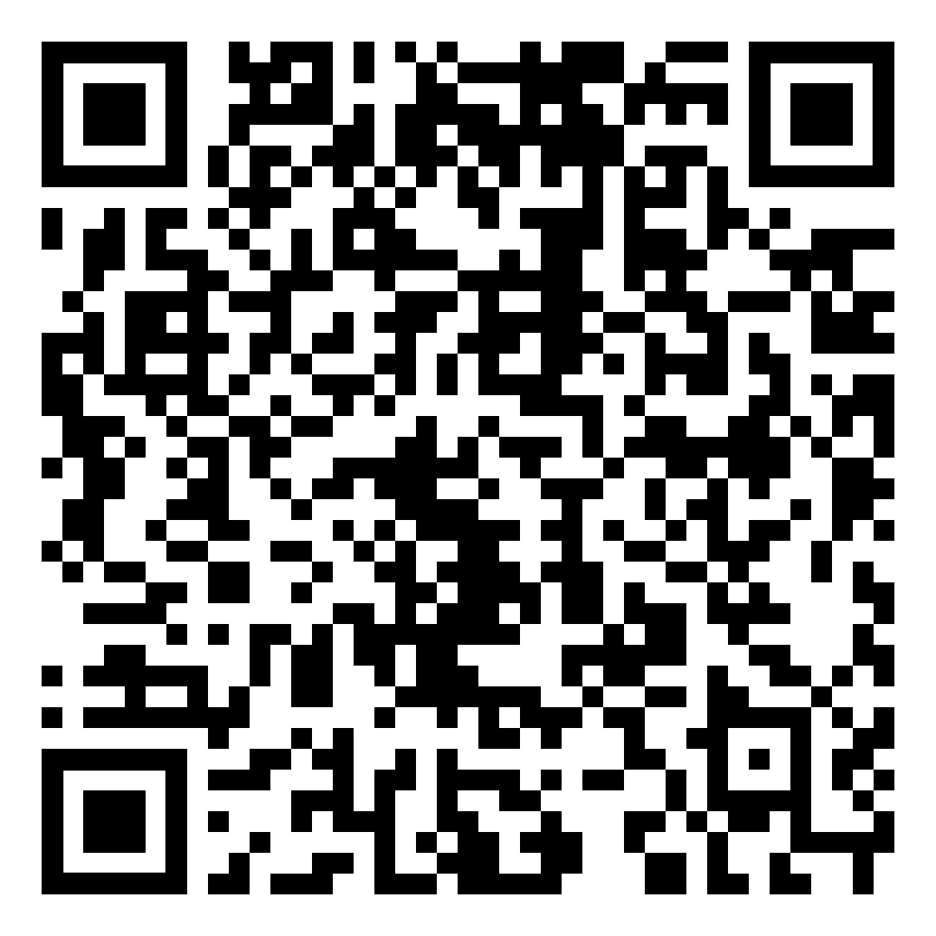
Thank you!
Recommended reading
Lecture video
Follow me on LinkedIn.

